Slide 1
The Characteristics & Heart
of Leadership

Slide 2
Agenda
Praise and worship
Welcome & Prayer
Discussion Questions Review
Teaching – Characteristics of Leadership - Session I
Break
Teaching – Heart of Leadership - Session II
Questions and Answers
Action List
Distribute Materials
Close with prayer

Slide 3
Attitudes of Leadership – Review
  Foundational Attitudes of Leadership
  Pursuit of God
  Learner’s Attitude
  100% Commitment
Functional Attributes of Leadership
  Submission to Authority
  Servants Heart
  Humility / Dependence on God
Notes:
Foundational Attitudes
Pursuit of God must be our first focus
We must always have a learner’s attitude.. we will learn from “sages” and also from those we disciple
100% commitment = willingness to sacrifice
Functional Attitudes
Submission to Authority - You can only have authority if you are Under Authority!
Servants Heart - Jesus humbled himself and served
Humility / Dependence upon God - Everything I have is a gift from God

Slide 4
Basis of Leadership
God gives five fold ministers (apostles, prophets, evangelists, pastors, teachers) to equip the rest of the body for leadership
  Ephesians 4:11-12 Pastors (shepherds) “... to equip the saints”
God sees you as a leader
  Judges 6:11-14 “... do I not send you?” God selects Gideon. Gideon struggles with seeing himself as a leader
    Many of us struggle with seeing ourselves as a leader. God sees it so you should too!
  1 Tim 3:1 Aspire to leadership
Notes:
The New Testament church had a leadership team. It was not one person. We are to train people to be leaders
The burden of leadership must be shared
Jesus modeled this in that he chose the 12
Paul modeled this with Titus, Timothy, Silas, etc.
The New Testament church is a team effort
The Leaders (Pastors) in the 5-fold ministry are to prepare leaders
We must grow and move from “milk” to “meat”
-------------------------
Tell story of first time in leadership (Growth Group Crash Course)
- felt presumptuous, scared, nothing to offer
- made lots of mistakes, people left our group and the church too ... REALLY??
- learned to walk in the success of the Holy Spirit
- learned to expect God to use me as vessel for his work
----------------------
Eph 11-12 And he gave the apostles, the prophets, the evangelists, the shepherds and teachers, 12 to equip the saints for the work of ministry, for building up the body of Christ,
Judges 6:14 And the Lord turned to him and said, “Go in this might of yours and save Israel from the hand of Midian; do not I send you?”
1 Tim 3:1 The saying is trustworthy: If anyone aspires to the office of overseer, he desires a noble task.

Slide 5
What is a Leader? (characteristics)
A leader is a man or woman of the Word and prayer!
  Deuteronomy 17: 18 - 20 “... And it shall be with him , and he shall read in it all the days of his life ...”
  We must know God...so we can make Him known to those we lead!
A leader is a lover!
  John 13:35 “By this all men will know that you are my disciples [LIKE ME] if you love one another.”
  “A leader is never a loner and a loner is never a leader”, Hendricks
Notes:
A Christian leader MUST have a relationship with Jesus. Be a man or woman of prayer, a read the bible and a desire to know God more.
If your tank is full, you can fill someone else's
You can only take someone else as far as you’ve gone
Know names!! Highest sign of value and that you are a shepherd.
Be a lover first. Be patient, be kind, be long suffering, be truthful. Give the love of God out.
Don’t be a loner! It is important to just spend time with others and impart your life to them ... an agenda is not necessary but just spend time with them and let God do encouraging things in that time. Much more is “caught” than “taught”.

Slide 6

Never go anywhere alone...

Slide 7
Never go anywhere alone...
ALWAYS
take someone with you.

Slide 8
What is a Leader? (characteristics)
A leader sets a consistent example and is a disciplined individual
  Disciplined:
    Spiritually
    Physically (exercise, eating habits)
    Appearance
    Finances
    Lusts (desires)
    Thought life
    Schedule - LIFE PLAN
Notes:
Be a consistent example. Be real but remember that those who you lead are looking to you to model an example of a consistent walk with Christ.
Psalms 4 “Be angry, and do not sin; ponder in your own hearts on your beds, and be silent.”
Don’t allow yourself to be moody. Don’t be controlled by the flesh
There is a difference between being moody and dealing with a real loss.
Disciplined individual
1 Sam 16: 7 “... man looks on the outward appearance, but the Lord looks on the heart”. Be wise and take care of your outward appearance. It is a witness to those who don’t know Christ.
Build yourself up, concentrate on good things. Take every thought captive.
Prov 23:7 “For as he thinks within himself, so he is...”
Be an overcomer not a victim
Do your life plan, put it on a calendar and then do it.

Slide 9
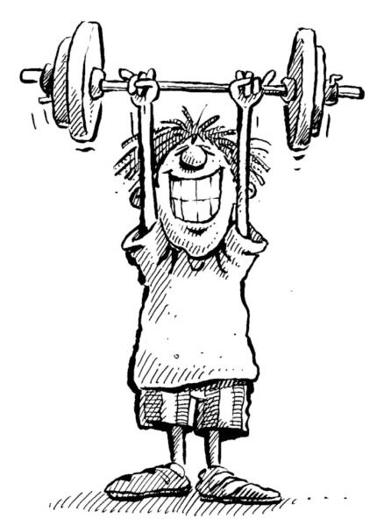
Discipline Does Not Equal Perfection. Discipline, however, is necessary if you are going to lead well!

Slide 10
What is a Leader? (characteristics)
A leader is perceptive.
  Perceptive defined: Responsive to sensory stimulus (discerning); characterized by sympathetic understanding or insight
  A leader sees not only the present but also the future ... sees God given potential in others.
A leader is teachable
  2 Peter 3:18 “But grow in the grace and knowledge of our Lord and Savior Jesus Christ.”
  We should have a genuine desire to learn and grow! Never go to a meeting without paper and pen!
Notes:
Be perceptive
listen first
ask questions
look to the Holy Spirit to give you discernment and understanding
be very slow to draw conclusions or to pass judgement
Be sensitive of where your people are, why they’re there and how you can take them where they need to go!

Slide 11
What is a Leader? (characteristics)
A leader is faithful
  1 Corinth 4:1-2 “¹This is how one should regard us, as servants of Christ and stewards of the mysteries of God. ²Moreover, it is required of stewards that they be found trustworthy”
  faithful in little things (small responsibilities)
  faithful in another mans ministry (serving others)
  faithful in finances (100% belongs to Him)
    Tithing, Pay your bills, Budget
Notes:
Be Faithful
Be faithful in the little things (Luke 16:10) - As you are faithful in the small tasks (showing up on time, helping in a ministry like greeting, etc.) you will be qualified to take on more responsibility. And, because you have shown yourself faithful in the small things (practice for bigger things), you’ll be better prepared for the big things.
Be faithful in another’s ministry (1 Cor 3:10-14) - “... Let each one take care how he builds upon it.” - Paul has laid a foundation on Jesus Christ and is charging those that come after him to be careful to build upon what he has done as if they are building upon Jesus’ work itself.
Be faithful in finances
God will use us to help train others for greater tasks than perhaps we have been given - Be assured that God has a purpose for you. However, he will certainly use you to help others who may have a different purpose which seems more lofty than yours. Take a look at Ananias and Paul (Acts 9:10-19). Without the faith and obedience of Ananias Paul may never have become the great apostle he became.

Slide 12
What is a Leader? (characteristics)
A leader is a reproducer!
  Jesus was a great leader, not because he had followers, but because he reproduced leaders!
  Jesus reproduced himself!
  The mark of your leadership is:
    Are you reproducing Jesus in others?
  Are you seeing new leaders as a result of our ministry?
Notes:
Reproduction must occur
Numbers are not the end goal. What matters is that you reproduce “after your own kind”.
Jesus reproduced himself. Jesus prayed for leaders and then selected the 12
The mark of your leadership is the reproduction of others

Slide 13

Break Time
Be back in
10 minutes!

Slide 14
Characteristics of Leadership, Part 1 Review
Basis of Leadership - Ephesians 4:11-12
  Leaders (Pastors) “... equip the saints”
What is a Leader? (characteristics)
  A man or woman of the word and prayer
  A lover
  A disciplined individual
  Perceptive
  Teachable
  Faithful
  A Reproducer

Slide 15
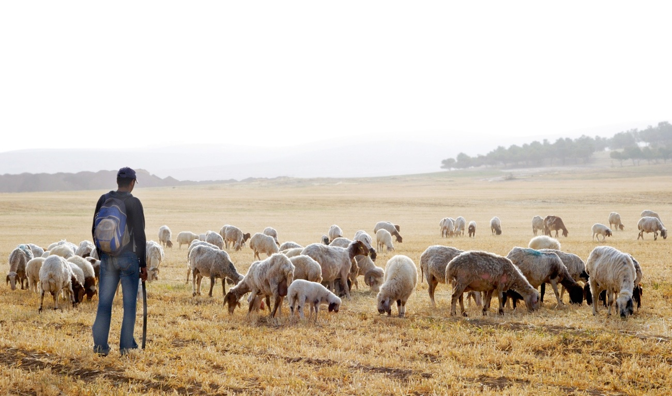
A Good Shepherd

Slide 16
The Leader’s Heart
As leaders, our expression of love to God goes beyond the singing and clapping to taking care of the sheep!
  John 21: 14-17, “Do you love me ... shepherd my sheep.”
  Matt. 9:35-38, “They were like sheep without a shepherd.”
Our Biblical challenge: The Holy Spirit has made us overseers; responsible for guarding the flock!
  Acts 20:28-31, “Be on guard... for the flock, which the Holy Spirit has made you overseers.”
Notes:
Jesus expressed His love for the Father by having a love and care for the sheep!
A leader can be taught but a Shepherds Heart comes from the HOLY SPIRIT
A leader has to desire to meet others needs. We need to minister to others!!
Spiritual maturity is based on how much you love HIS SHEEP
Don’t forget, Satan always attacks the Shepherd first. If you are RIGHT and stay true to God, the flock will be all right.

Slide 17
Shepherd’s Heart
Shepherds must have a shepherd’s heart!
  Jer 3:15, “Shepherds after my own heart... who will feed...”
  Jer 23:1-2, “Woe to shepherds who are scattering...”
    vs. 4, “I will raise up shepherds... they will tend them... nor will any be missing.”
God’s shepherds heart is concerned for each sheep, that none be lost (a heart for HIS sheep... individually)
  Matt. 18:12-14, “... leaves the 99 ... for the one straying.”
    vs. 15, (in the same context of shepherding and caring), “If a brother sins, ... go ...”
Notes:
Teaching does not always equal Shepherding.
Great teachers are not always great shepherds. The body needs both and a Growth Group leader is called to be a shepherd first.

Slide 18
Tips from the Good Shepherd
John 10:1-15, The Good Shepherd
  He knows them by name and meets their needs, vs. 3, 15
  He lays down His life for the sheep, vs. 11
  He protects them from danger, vs. 12 - 13
  He is the door, vs. 7
    He assumes responsibility - Ex: Shepherds lay on the ground - sheep or thief must pass over
  He leads them into pastures / growth, vs. 4
  He goes before them, vs. 4
    Never pushes where he has not gone. Leads the way in spiritual growth!

Slide 19
Tips from the Good Shepherd
Such understanding is necessary to rightly lead a fundamental building block to our mission:

Slide 20

Tips from the Good Shepherd
Such understanding is necessary to rightly lead a fundamental building block to our mission:

Slide 21
Purpose of a
Growth Group (GG)
Personal Spiritual Growth
  Bible Study, challenged to do daily devotions & prayer
  Challenged to live what is taught from pulpit
  Your example to them
Relational Growth
  Interaction with believers in the group setting
  Sharing life (change, problems, victories)
  Having a family within the BODY OF CHRIST
Numerical Growth
  Team ministry - More can be ministered to
  Each Growth Group Leader is an under-shepherd ... a Pastor for their Growth Group
Notes:
Different from a Devotion Group
Devotion Group is low key, at a public place, focus on reading the word and sharing, very little if any training needed for the leader
Growth Group is a small church in your home, focus is on discipleship, training required for the leader
350 attendees, 320 without Children’s Ark
Target 10 - 14 people (including leaders) for a Growth Group
Target 80% of attendees to be in a Growth Group = 256 people
256 / 12 = 21 --- We need 21 Growth Groups

Slide 22
Mission Statement for SG’s
NHT SMALL GROUP MISSION
To disciple the SAINTS of NHT for Jesus Christ by imparting our lives in the context of devotion groups, growth groups and discipleship groups. To reproduce Jesus into the life of every small group member. To equip and release leaders to continue the discipleship until Jesus returns

Slide 23

Questions?

Slide 24

Action List (Prep for Next Week)
Have Devotions & Prayer Daily
Read “Master Plan of Evangelism” by Robert E. Coleman.
Listen to ”Art of Disciple-making”, and “Biblical Principles of Group Dynamics” by Howard Hendricks.
Complete your Growth Group Flyer Sheet.
Complete the Online Discussion Questions
Notes:
It is very important that you complete the items in the ACTION LIST. If you fall behind, it will be hard to catch-up.
There will be a quiz at the start of the sessions on Week #4.

Slide 25

Conclude
Assign Refreshments
Close with prayer.

